Slide 1
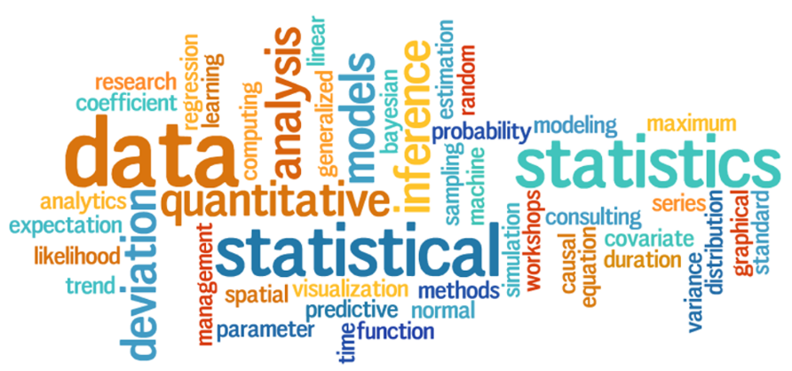
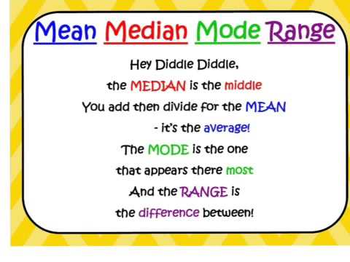
My Statistics Interactive Notebook
Name:
Class: 9-9
Teacher: Mr Evans
Term 3 Semester 2

Slide 2


Slide 3
Warm Up
What do the following mean in relation to Similar Triangle proofs?
SSS
SAS
RHS
AAA

Slide 4
24
7
30
Date
Measures of Location
EQ – What are the measures of location in statistics and how do we find them?
What are measures of
location?
The three most common measures of location are the mean, the median, and the mode.
How do we find the measures of location?
Mean – Most commonly used measure of central tendency
Average of all observations
The sum of all the scores divided by the number of scores
Affected by Extreme Values (Outliers)
Example I
Data: 8, 4, 2, 6, 10

Slide 5
24
7
30
Date
Measures of Location
EQ – What are the measures of location in statistics and how do we find them?
How do we find the measures of location?
Example II
Sample: 10 trees randomly selected from Battle Park
Diameter (inches):
9.8, 10.2, 10.1, 14.5, 17.5, 13.9, 20.0, 15.5, 7.8, 24.5

Slide 6
24
7
30
Date
Measures of Location
EQ – What are the measures of location in statistics and how do we find them?
How do we find the measures of location?
Median – This is the value of a variable such that half of the observations are above and half are below this value i.e. this value divides the distribution into two groups of equal size
When the number of observations is odd, the median is simply equal to the middle value
When the number of observations is even, we take the median to be the average of the two values in the middle of the distribution
Not Affected by Extreme Values
Example I
Data: 8, 4, 2, 6, 10
2, 4, 6, 8, 10
median: 6

Slide 7
24
7
30
Date
Measures of Location
EQ – What are the measures of location in statistics and how do we find them?
How do we find the measures of location?
Example II
Sample: 10 trees randomly selected from Battle Park
Diameter (inches):
9.8, 10.2, 10.1, 14.5, 17.5, 13.9, 20.0, 15.5, 7.8, 24.5
7.8, 9.8, 10.1, 10.2, 13.9, 14.5, 15.5, 17.5, 20.0, 24.5
median: (13.9 + 14.5) / 2 = 14.2

Slide 8
24
7
30
Date
Measures of Location
EQ – What are the measures of location in statistics and how do we find them?
How do we find the measures of location?
Mode - This is the most frequently occurring value in the distribution
Value that Occurs Most Often
Not Affected by Extreme Values
There May Not be a Mode
There May be Several Modes
0 1 2 3 4 5 6 7 8 9 10 11 12 13 14
Mode = 9

Slide 9
Let’s try some together.
Find the Mean, Median and Mode of these sets of numbers.
3, 3, 5, 6, 6, 6, 7, 8, 12, 14, 15
13, 16, 17, 18, 21, 24, 25, 26
11, 14, 14, 17, 18, 18, 21, 24

Slide 10
Try these on your own. Use your notes if you need to.
Find the Mean, Median and Mode for the following.

Slide 11
Complete your Summary ensuring you explain the process you use to find the measures of location.

Slide 12
Notes Review
24, 7 ,30
Date
Title
Essential question
Notes complete
Notes complete with colour and diagrams
Questions completed
Contents page filed in
Formula page filled in

Slide 13
Homework
Review your notes and write a summary answering the essential question.

